Slide 1
APPLETS

Slide 2
Java Program Patterns
Applications
  Java programs which run stand alone.
Web-based Java Applications
  Applets
    applets are small applications that are accessed on an Internet server, transported over the Internet, automatically installed, and run as part of a Web document(browser).
  Servlets
    Programs that run inside request/response oriented servers.
  JavaServer Pages
    An extension to the servlet architecture. Allow for the separation of the display of web content and the generation of that content.

Slide 3
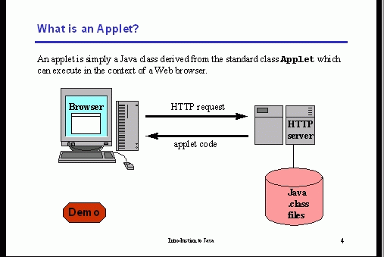
Anumita Jha

Slide 4
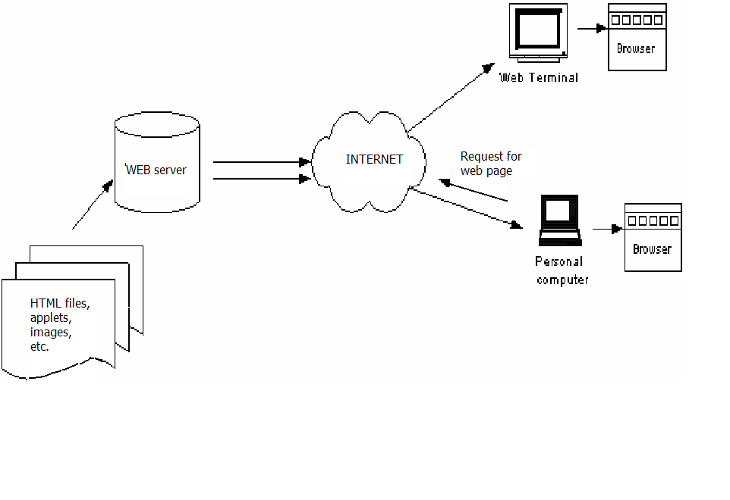
Web Browsers Accessing a Web Page
User enters URL for a web site …………..

Slide 5
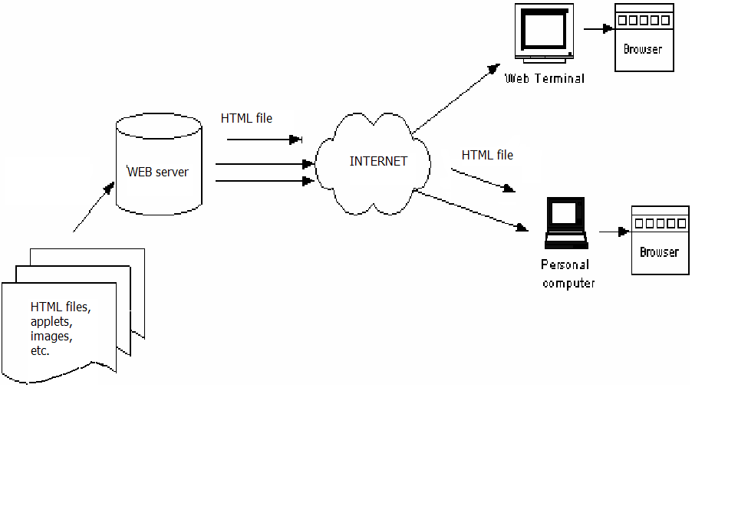
HTML file sent back from web server ………..

Slide 6
An applet is accessed by an HTML file.
An applet runs in the context of a browser.
HTML is a ‘mark-up’ language (it adds to text content by marking it up with tags)
You include applets in HTML pages by using the <APPLET> tag.
Browsers display the text and process (render) the tags
For example, a file might begin with the line:
CIS255 <i> Homework </i> Assignment
The browser would display:
CIS255 Homework Assignment

Slide 7
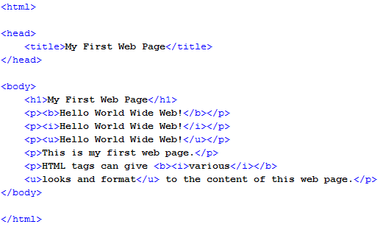
Anumita Jha

Slide 8
Other HTML Tags
<b> bold </b> , <u> underline</u>
<img src="hamster.jpeg" width="640" height="480“ alt="A photo of hamster" >
Link to another file:
<a href="http://java.sun.com>Java</a>
Include an applet:
<applet code="HamsterApplet.class"
width="640" height="480">
</applet>

Slide 9
<HTML>
<u> here comes an applet </u>
<applet code= “file.class” width =500 height=500>
</applet>
</HTML>
When a browser renders this HTML file, it will display underlined text and the applet whose byte code is in the file “file.class”

Slide 10
Sequence of operations when an browser user visits a web page containing applet
The browser finds the class file (which contains Java bytecodes) for the applet's Applet subclass.
The browser brings the Applet subclass bytecodes over the network to the user's computer.
The browser creates an instance of the Applet subclass. (When we refer to an applet, we're generally referring to this instance.)
The browser calls the applet's init method. This method performs any initialization that is required.
The browser calls the applet's start method. This method often starts a thread to perform the applet's duties.

Slide 11
Applets
How Applets and applications are different
  Applications are standalone, while applets run under the
  control of a web browser.
  Applets can run in our browser's window or in an appletviewer.
  Applets can be downloaded from a server by a Web browser
  Applets have restrictions
    Cannot read or write to reader's file system.
    Usually cannot communicate with other servers
    Cannot run programs on the reader's system
    Cannot load programs to the local platform
  Applets do not have main method and its execution starts from init() method.
  Applets are designed just for handling the client site problems. while the java applications are designed to work with the client as well as server.
  Output to your applet’s window is not performed by System.out.println( ). Rather, it is handled with various AWT methods, such as drawString( ), which outputs a string to a specified X,Y location.
Notes:
When designing an applet, you must remember the things that an applet cannot do. Some Web browsers or applet viewers may place different restrictions on applets. In general, applets cannot:
read files on a local system
write files to the local system
delete files on the local system
rename files on the local system
create a directory on the local system
list directory contents
check for the existence of a file
obtain the type, size or modification time of a file
create a network connection to a system other than the one it was loaded from
define system properties
invoke any program on the local system
manipulate any threadgroup, other than its own
access or load classes other than the standard ones in Java api
define classes that are part of packages on the local system

Slide 12
Applet fundamentals
//simple java applet
import java.awt.*;
import java.applet.*;
public class SimpleApplet extends Applet {
public void paint(Graphics g) {
g.drawString("A Simple Applet", 20, 20);
}
}
Every applet that you create must be a subclass of Applet.
Applet class must be declared as public, because it will be accessed by code that is outside the program.

Slide 13
Contd……
paint( ) is called each time that the applet must redisplay its output.
  when the applet begins execution.
  the window in which the applet is running can be overwritten by another window and then uncovered.
  the applet window can be minimized and then restored.
The paint( ) method has one parameter of type Graphics.
drawString( ), which is a member of the Graphics class.This method outputs a string beginning at the specified X,Y location.It has the following general form:
void drawString(String message, int x, int y)

Slide 14
Applet skeleton
// An Applet skeleton.
import java.awt.*;
import java.applet.*;
/*
<applet code="AppletSkel" width=300 height=100>
</applet>
*/
public class AppletSkel extends Applet {
// Called first.
public void init() {
// initialization
}
/* Called second, after init(). Also called whenever the applet is restarted. */
public void start() {
// start or resume execution
}
// Called when the applet is stopped.
public void stop() {
// suspends execution
}
/* Called when applet is terminated. This is the last method executed. */
public void destroy() {
// perform shutdown activities
}
// Called when an applet's window must be restored.
public void paint(Graphics g) {
// redisplay contents of window
}
}
Not every applet needs to override every one of these methods. Some simple applets override none of them.

Slide 15
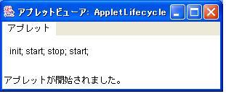
The Life Cycle of an Applet
import java.applet.Applet;
import java.awt.Graphics;
/*
<applet code="AppletLifecycle" width=300 height=50>
</applet>
*/
public class AppletLifecycle extends Applet {
String str = "";
public void init() {
str += "init; ";
}
public void start() {
str += "start; ";
}
public void stop() {
str += "stop; ";
}
public void destroy() {
System.out.println("destroy");
}
public void paint(Graphics g) {
g.drawString(str, 10, 25);
}
}
init() : called only when the applet begins execution.
start() : executed after init() method. Called by the applet viewer or Web browser.
stop() : when applet viewer is minimized.
destroy() : called by the applet viewer or Web browser before the applet is terminated.

Slide 16
Contd…….
When an applet begins, the AWT calls the following methods, in this sequence:
1. init( )--first method to be called. This is where you should initialize variables. This method is called only once during the run time of your applet.
2. start( )-- is called after init( ). It is also called to restart an applet after it has been stopped. start( ) is called each time an applet’s HTML document is displayed onscreen. So, if a user leaves a web page and comes back, the applet resumes execution at start( ).
3. paint( )– is called
  the window in which the applet is running may be overwritten by another window and then uncovered.
  Applet window may be minimized and then restored.
  paint( ) is also called when the applet begins execution.

Slide 17
Contd…
When an applet is terminated, the following sequence of method calls takes place:
1. stop( )-- The stop( ) method is called when a web browser leaves the HTML document containing the applet—when it goes to another page, for example.
2. destroy( )--The destroy( ) method is called when the environment determines that your applet needs to be removed completely from memory. The stop( ) method is always called before destroy( ).

Slide 18
Painting
Painting is how the applet displays something onscreen
Can occur many times during the applet lifetime
public void paint(Graphics g) { }
The paint method is automatically called by browser when the applet window must be redrawn
Call the repaint() method to request that applet window be redrawn
The Applet class contains a paint method, but it doesn’t do anything, you must override it

Slide 19
Creating an Applet and executing
Your Java source file contains code which implements your applet.
Compile the source file to produce class file.
Make an HTML file with the applet tag that references that class file.
Two ways to run an applet after compiling applet file and creating HTML file
Use browser to execute that HTML file – enter the name of html file in URL of web browser and press enter .
run appletviewer utility. (C:\>appletviewer RunApp.html)
NOTE:
An applet viewer executes your applet in a window. This is generally the fastest and easiest way to test your applet and used to debug the applet.

Slide 20
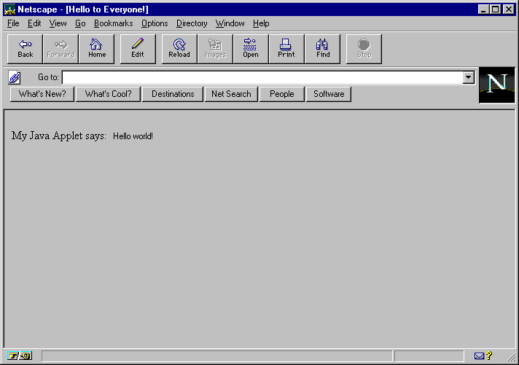
First Applet

Slide 21
The Applet Class
Applet provides all necessary support for applet execution, such as starting and stopping.
It also provides methods that load and display images, and methods that load and play audio clips.
Methods:
String getAppletInfo( ) - Returns a string that describes the applet.
AudioClip getAudioClip(URL url)- Returns an AudioClip object that encapsulates the audio clip found at the
location specified by url.
Image getImage(URL url) - Returns an Image object that
encapsulates the image found at the location specified by url.
Refer text book for more methods

Slide 22
Control flow in applet
Applets are event driven
event handler should be written
In case of Applets ,the main control is with AWT (abstract window toolkit) or Web browser
As soon as the applet class is run, the browser calls lifecycle methods such as init,start,paint to initilize and start and paint an applet.

Slide 23
The Graphics Class
Methods of Graphics Class
import java.applet.Applet;
import java.awt.Graphics;
/*
<applet code="DrawArc" width=200 height=200>
</applet>
*/
pulic class DrawArc extends Applet {
public void paint(Graphics g) {
g.drawArc(20, 20, 160, 160, 0, 135);
}
}
abstract void drawArc(int x, int y, int w, int h, int degreesO, int degrees1)
abstract boolean drawImage(Image img, int x, int y, ImageObserver io)
abstract void drawLine(int x0, int y0, int x, int y1)
abstract void drawOval(int x, int y, int w, int h)
abstract void drawPolygon(int x[], int u[], int n)
abstract void drawPolyline(int x[], int y[], int n)
void drawRect(int x, int y, int w, int h)
abstract void drawString(String str, int x, int y)
abstract void fillArc(int x, int y, int w, int h, int degree0, int degree1)
abstract void fillOval(int x ,int y, int w, int h)
abstract void fillPolygon(int x[], int y[], int n)
void fillRect(int x, int y, int w, int h)
abstract Color getColor()
abstract Font getFont()
abstract FontMetrics getFontMetrics()
abstract void setColor(Color c)
abstract void setFont(Font f)
http://java.sun.com/j2se/1.5.0/docs/api/java/awt/Graphics.html

Slide 24
Setting background and Foreground color
The Component class of AWT has two member methods namely
setForeground(Color newcolor)
setBackground(Color newcolor)
Color getBackground()
Color getForeground()
These methods help in changing and getting background and Foreground colors of the applet
Example applet to do the same is as follows(Demo)
public void init(){
setBackground(Color.cyan);
setForeground(Color.magenta);}

Slide 25
import java.awt.*;
import java.applet.*;
/*
<applet code="Sample" width=300 height=50>
</applet>
*/
public class Sample extends Applet{
String msg;
// set the foreground and background colors.
public void init() {
setBackground(Color.cyan);
setForeground(Color.red);
msg = "Inside init( ) --";
}
// Initialize the string to be displayed.
public void start() {
msg += " Inside start( ) --";
}
// Display msg in applet window.
public void paint(Graphics g) {
msg += " Inside paint( ).";
g.drawString(msg, 10, 30);
}
}

Slide 26
Repaint
paint() is not invoked by the programmer.
When an applet needs to redrawn you place a call to repaint() which calls paint().
It is defined in Component class of AWT
This causes call to update, followed by paint
Thus after initial display,if u want any change ,make such a change
and call repaint method.
There are 4 forms of these methods
void repaint(), void repaint(int l.int t,int w,int h);
void repaint(long millisec); void repaint(long ms,int l,int t,int w,int h)
Calling repaint() is essentially a request that your applet should be
redrawn.If your system is slow or very busy it may club multiple repaint requests over a time period and call once update().
To overcome the above problem ,the last two forms may be of use.
The time parameter in these indicate maximum no.of milliseconds that can elapse before update() is called.

Slide 27
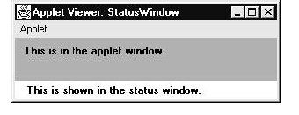
Using the status window
// Using the Status Window.
import java.awt.*;
import java.applet.*;
/*
<applet code="StatusWindowdemo" width=300 height=50>
</applet>
*/
public class StatusWindowdemo extends Applet{
public void init() {
setBackground(Color.cyan);
}
// Display msg in applet window.
public void paint(Graphics g) {
g.drawString("This is in the applet window.", 10, 20);
showStatus("This is shown in the status window.");
}
}

Slide 28
Applets and Threads
It is required that the paint method should be very small and hand over the control very soon back to awt.
Hence looping,recursive calls etc cannot be achieved in usual manner(no looping in paint())
Whenever such requirement arises ,u need to define and initialize a separate flow of control (thread) to perform the looping ,or any other steps taking more time and return main flow of control.
Ex: In case of animation
Ex: Scrolling messages, images etc

Slide 29
Applet and Threads:Simple Banner applet
/* A simple banner applet.This applet creates a thread that scrolls the message contained in msg right to left across the applet's window.*/
import java.awt.*;
import java.applet.*;
/*<applet code="SimpleBanner" width=300 height=50>
</applet>*/
public class SimpleBanner extends Applet implements Runnable {
String msg = " A Simple Moving Banner.";
Thread t = null;
boolean stopFlag;
// Set colors and initialize thread.
public void init() {
setBackground(Color.cyan);
setForeground(Color.red);
}

Slide 30
Contd…
// Start thread
public void start() {
t = new Thread(this);
stopFlag = false;
t.start();
}
// Entry point for the thread that runs the banner.
public void run() {
char ch;
// Display banner
for( ; ; ) {
try {
repaint();
Thread.sleep(250);
ch = msg.charAt(0);
msg = msg.substring(1, msg.length());
msg += ch;
if(stopFlag==true)
break;
} catch(InterruptedException e) {}
}
}

Slide 31
Contd….
// Pause the banner.
public void stop() {
stopFlag = true;
t = null;
}
// Display the banner.
public void paint(Graphics g) {
g.drawString(msg, 50, 30);
}
}

Slide 32
The Applet class & Passing Parameter
import java.applet.*;
import java.awt.*;
/*
<applet code="AppletParameters" width=300 height=300>
<param name="background" value="0xffffff">
<param name="foreground" value="0x000000">
<param name="message" value="Testing Applet Parameters">
</applet>
*/
public class AppletParameters extends Applet {
public void paint(Graphics g) {
String background = getParameter("background");
String foreground = getParameter("foreground");
String message = getParameter("message");
setBackground(Color.decode(background));
setForeground(Color.decode(foreground));
g.drawString(message, x, y);
}
}

Slide 33
Applet class members
Refer java AP
URL getDocumentBase() and URL getCodeBase() methods help you to get URL’s of document and the applet inside.
import java.awt.*;
import java.applet.*;
import java.net.*;
/*
<applet code="Bases" width=300 height=50>
</applet>
*/
public class Bases extends Applet{
// Display code and document bases.

Slide 34
Applet class members
public void paint(Graphics g) {
String msg;
URL url = getCodeBase(); // return directory hierarchy where applet is saved
msg = "Code base: " + url.toString();
g.drawString(msg, 10, 20);
url = getDocumentBase(); // return directory hierarchy where HTML is saved
msg = "Document base: " + url.toString();
g.drawString(msg, 10, 40);
}
}

Slide 35
The AppletContext Interface
import java.applet.*;
import java.awt.*;
import java.net.*;
/* <applet code="ShowDocument" width=200 height=50>
</applet>*/
public class ShowDocument extends Applet {
public void init() {
AppletContext ac = getAppletContext();
try {
URL url = new URL("http://www.osborne.com");
ac.showDocument(url, "frame2");
}
catch(Exception e) {
showStatus("Exception: " + e);
}
}
public void paint(Graphics g) {
g.drawString("ShowDocument Applet", 10, 25);
}
}
AppletContext Interface
Applet getApplet(String appName)
Enumeration getApplets()
AudioClip getAudioClip(URL url)
Image getImage(URL url)
void showDocument(URL url)
void showDocument(URL url, String target)
void showStatus(String str)

